Slide 1
Cyber Forensics
Brief Introduction to Area’s Tools and approach to ctf

Slide 2
Our Plan for Today
What is cyber forensics?
Terms you need to know in cyber forensics
Evidence Hashing,Legal aspects of cyber forensics.
Introduction to Network Forensics and Wireshark Tool(,Basic protocols,packet sniffing and ctf questions.)
Audio forensics(with examples),Steganography(with examples)
Introduction to malwares and Memory Forensics.

Slide 3
Cyber forensics
Discipline that combines the elements of civilianlaw and computer science which helps us to analyze computer networks,Communication systems and Mobile Networks
Cyber forensics plays a vital role in the field of Information security.It is used as an immediate security response after a cyber attack.
Mishandling of Information by a forensics can lead to great alterations in the cases.
The main problem in the field is the improper updation of the laws based on new attacks.

Slide 4
Cyber Forensics is forensics applied to information stored or transported on computers
It “involves the preservation, identification, extraction, documentation, and interpretation of computer media for evidentiary and/or root cause analysis”
Procedures are followed, but flexibility is expected and encouraged, because the unusual will be encountered.

Slide 5
Three A’s of Cyber Forensics
Acquire the evidence without altering or damaging the original
Authenticate the Evidence.
Analyze the data without modifiying it.

Slide 6
Acquire the evidence
How do we seize the electronic device
Handling the computer device
1.Chain of custody
2.Evidence collection
3.Evidence Identification
4.Transportation
5.Storage.

Slide 7
What is digital evidence?
Can be anything
As small as a few bytes
Could be, and hopefully will be complete files
Could be Deleted
Could be Encrypted
Likely will be fragments of files
A few Words
A couple of sentences
Hopefully some paragraphs
Registry entries, or log entries!

Slide 8
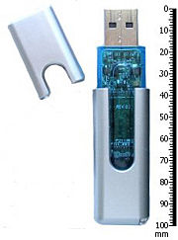
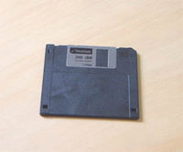
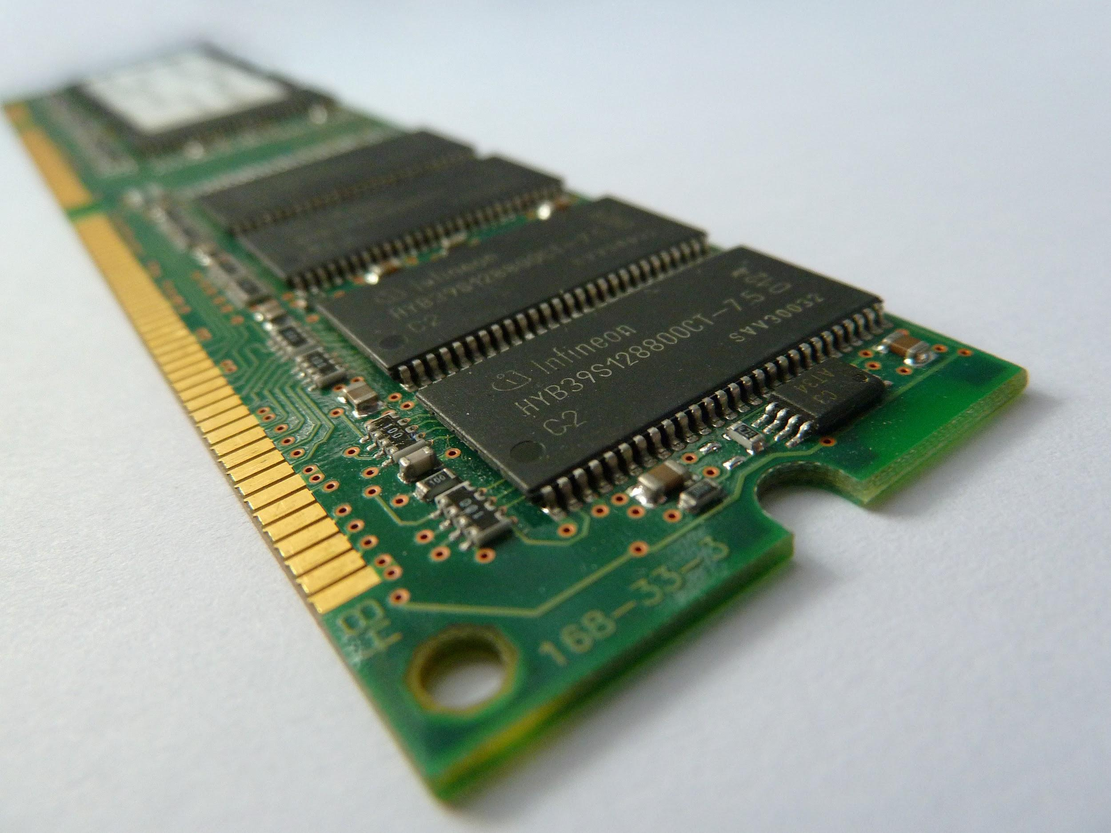
Where can we get the evidence?
1.Storage Devices
2.RAM files
3.Log files
4.Registry

Slide 9
Authenticate the Evidence
Proving that the evidence is what the criminal has left behind.
This is done by hashing the values.
Some of the hashing functions are
MD5
SHA-1,SHA-256,SHA-512

Slide 10
Evidence Hashing.
In authentication, hashing is used to create a set of numbers that represent a drive or set of files. This is similar to fingerprinting someone. With hashing, a finger print is created from the evidence. No details about the evidence can be determined from the hash value, but if the evidence is altered in any way, the hash value will also change.
1.MD5 hashing Algorithm(218 bit message)
2.SHA-1,SHA-224,SHA-256,SHA-384,SHA-512

Slide 11
Analysis of the Evidence
1.Always work on the copy image of the Acquired evidence.
2.Prevent damage to the evidence by safeguarding it.
3.Always take two backup of the evidence.
4.Check each and every aspect before coming to the conclusion

Slide 12
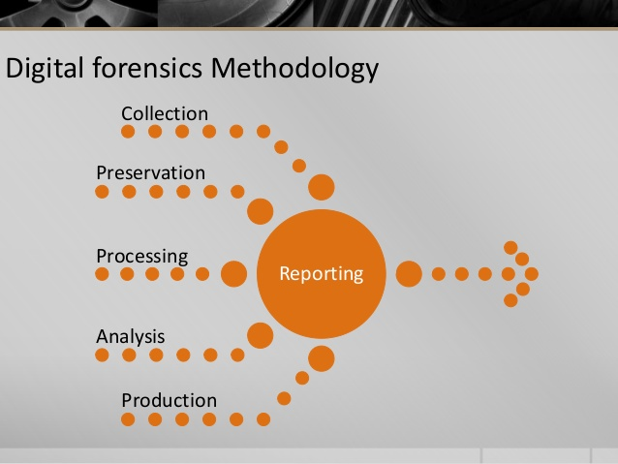

Slide 13
Many Branches of Forensics
Image Forensics
Memory Forensics
Browser Forensics
Network Forensics
Register Forensics
Smartphone Forensics
DataBase Forensics
File Carving
Audio Forensics
Malware Forensics
Artifacts Based Analysis
Imaging

Slide 14
Introduction to Network Forensics
Deals with monitoring and analysing computer network traffic for the purpose of information gathering ,legal evidence or intrusion detection.
Most of the attacks that happens today could be identified by analysing the network communication between the host and the attacker.
Network Forensics is considered as the top in the hierachy of Forensic Science.Since this analyses all the layers in which the internet that we see today is built upon.
The tool that Every Forensics guy should have is Wireshark.

Slide 15
Basic Protocols
TCP/IP -Splitting the information into packets in the initial stage and rearranging it in the destination.IP is used to route the packets into the correct location by the IP address attached to it.
UDP/ICMP-Used when small amount is passed through the Network.lacks error detection process that of TCP. ICMP is used for Diagnostic and management Process(ping and tracerat)
SMTP/POP3/IMAP Simple Mail Transfer Protocol is used for sending emails. Post Office Protocol third version is used for receiving the protocols.IMAP is Internet Mail Access protocol allows to read Individual Mail boxes at a single account
HTTPS/FTP :Transfers the data through the encrypted format. FTP is an old protocol it is used for transferring files in the Network.Primary use uploading files into web sites.

Slide 16

WIRESHARK
It is an open source tool and are used to sniff the packets going in and out of your network.
Used by R &D people to debug their protocol implementation.
Network Admins to troubleshoot their networks.
Network security engineers to discover security breaches and vulnerabilities in their network.

Slide 17
Wireshark can be downloaded from https://www.wireshark.org for free
Wireshark can be downloaded as an application or as a tailored source code where one can there own modification to it using lua programming language.
In linux we can Install wireshark by giving sudo apt-get install wireshark
It can be run in command line interface and as well as in GUI.

Slide 18
Let’s take an example……
“A cute Stegosaurus”
Admire our cutest stegosaurus ever!!!!!!

Slide 19
The Flag is
CTF{And_You_Thought_It_Was_In_The_Picture}

Slide 20
Image Forensics
1.File signatures.
2.Metadata and thumbnail
3.Reverse Image Searching
4.Fixing Chunks
Steganography
1.Encryption
2.Algorithms
3.In planes.

Slide 21
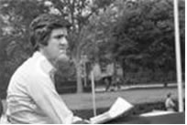


Image Forensics
Easy to be deceived.

Slide 22
Categories of Image Tampering
There are three main catogories of Image Tampering the are.
1.Enhancement
2.Composition
3.Copy Move

Slide 23
What can be done to protect the digital images?.
1.Watermarking
Fragile Watermarking
Semi-fragile Watermarking
2.Digital Fingerprinting/Signature
Digital Cameras with fingerprinting capabilities.

Slide 24
Steganography
Stegano meaning Covered graphy meaning Art.
The art and science of writing messages in such a way no one apart from the intended recipient even knows that a message has been sent.

Slide 25
Reasons for Using Image Steganography
It is the most widely used medium being used today.
Takes advantage of our limited visual perception of colors.
This field is expected to continually grow as computer graphics power also grows.
Many programs are available to apply steganography.Considered more efficient than Normal Cryptography.Works well when combined with Cryptography.

Slide 26
Image Based Techniques
Least Significant Bit Insertion.
Hiding Images Inside Another Image
Masking and Filtering.

Slide 27
LSB Insertion
A sample raster data for 3 pixels (9 bytes)
may be:
00100111 11101001 11001000
00100111 11001000 11101001
11001000 00100111 11101011
Inserting the binary value for (10000001)
changes 4 bits
00100111 11101000 11001000
00100110 11001000 11101000
11001000 00100110 11101011

Slide 28
Steganography
Steganography is the method of hiding data inside images.There are various methods used
1.Hiding files in images.
2.Manipulating the RGB pixels for hiding data
3.Hiding data in plain site
Steganography is better than that of Normal cryptography because the encrypted message itself does not attract attention.
Media files are ideal for steganography due to their large size.

Slide 29
LSB Uses.
Storing passwords and/or other confidential information.
Covert communication of sensitive data.
Speculated uses in terrorist activities.
Being widely used to hide and/or transfer illegal content.

Slide 30
Hiding Images Inside another Image.
Since the size of a given image is large,we can embed one image inside another.
The process of embedding can be done in many ways.
There are various open source tools that can be used to do this works.

Slide 31
Some tools for Steganography
Steghide
Stegdetect
Foremost
Pngcheck
Stegsolve
Binwalk

Slide 32
Masking and Filtering
Masks secret data over the original data by changing the luminance of particular areas.
During masking, it embed the message within significant bits of the cover image.
Not susceptible to lossy techniques because image manipulation does not affect the secret message.

Slide 33
Masking and Filtering uses
Digital Watermarking – provides identification pertaining to the owner; i.e. license or copyright information.
Fingerprinting – provides identification of the user; used to identify and track illegal use of content.

Slide 34
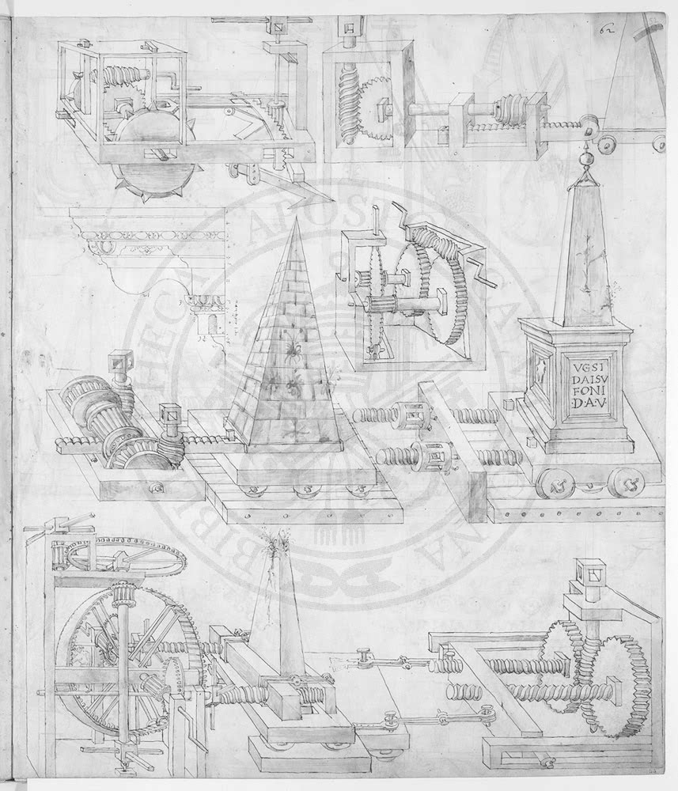
Visible Watermark Example

Slide 35
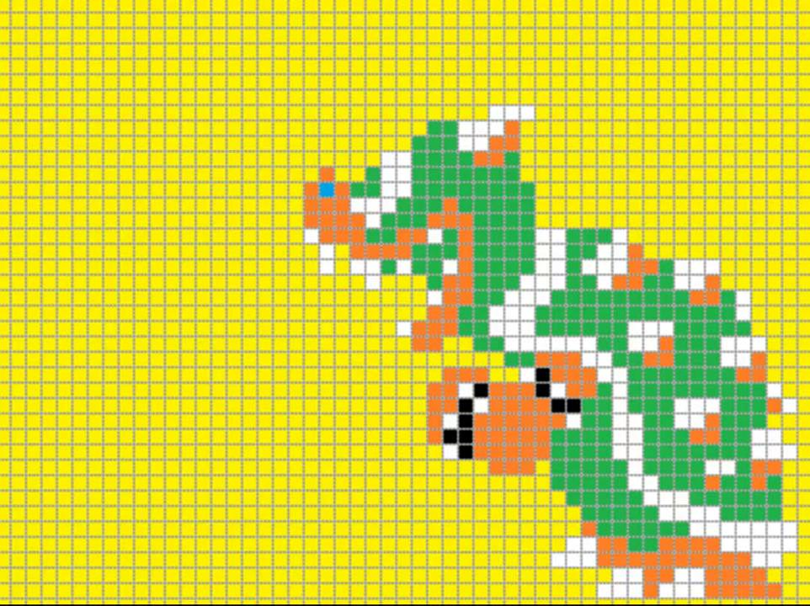
Let’s play Mario….

Slide 36
Audio Forensics
Audio Forensics deals with hiding Information in Sound waves.
The Tool used for Audio forensics is Audacity.
Audacity provides more than one ways to analyse the give wav and other audio related files.
We can use audacity for various purposes like Noise removal,Audio Manipulation and many other purposes.

Slide 37
Malware analysis
A Malware is a set of instructions that run on your computer and make your system do something that an attacker wants it to do
Malwares are used to
Steal personal information
Delete files
Click fraud
Steal software serial numbers
Use your computer as relay

Slide 38
Different type of Malware
1.Viruses:a program that can infect other programs by modifying them to include a, possibly evolved, version of itself
2.Trojan :A trojan describes the class of malware that appears to perform a desirable function but in fact performs undisclosed malicious functions that allow unauthorized access to the victim computer
3.Rootkit:A root kit is a component that uses stealth to maintain a persistent and undetectable presence on the machine

Slide 39

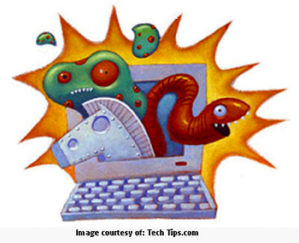
4.Worms:A computer worm is a self-replicating computer program. It uses a network to send copies of itself to other nodes and do so without any user intervention.

Slide 40
Analysis of Malware using Sandbox Analysis
Running the executable in a VM
Observe it
File activity
Network
Memory
After getting the memory dump the malicious dll’s are analysed and then the activity of the dll’s are matched to detect the type and property of the Malware
The Tool used here is Volatility

Slide 41
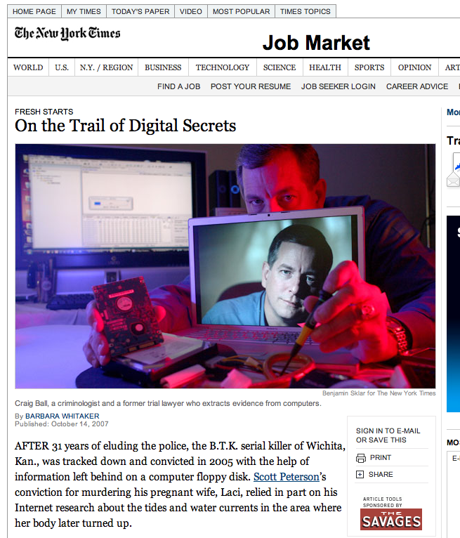
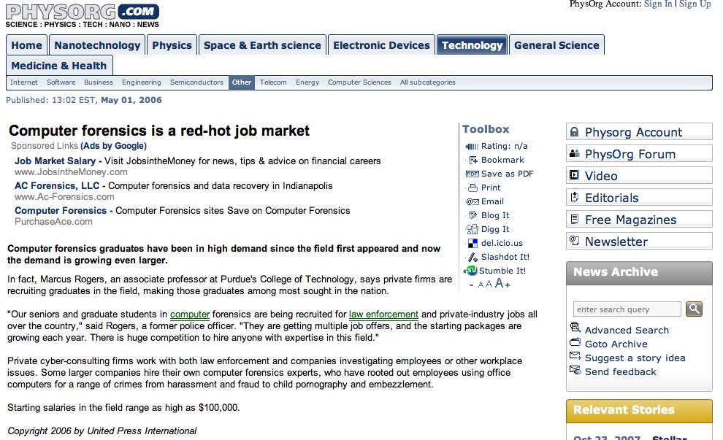
Career in Cyber Forensics

Slide 42
Professional Opportunities
Law Enforcement
Private Sector
Intelligence Community
Military
Academia

Slide 43
Summary
Cyber Forensics is a maturing forensic Science
AAFS new section Feb 2008
Excellent career opportunities
Proper education & training is paramount!

